Slide 1



Department of Computer Science and Engineering
MINI PROJECT - (BCS586)
Blood Group Detection Using Fingerprint
Batch No.: 2024_CSE_36
Student 1 1KS22CS129 Saketh A V
Student 2 1KS22CS163 Syed Ayan Hyder
Student 3 1KS22CS171 Thejus K
Student 4 1KS21CS013 Anubhav Misra
Guided By:
Prof.Roopesh Kumar
Associate Professor

Slide 2
Contents
Introduction
Literature Survey
Problem statement and objectives
System Requirement Specification (SRS)
Software Design Specification (SDS)
Technology/Tools used
Implementation of module with codes
Results
Future Enhancements
References

Slide 3
Introduction
Overview: This project explores an innovative approach to blood group detection using fingerprint patterns. Traditionally, blood group testing requires a blood sample, but using biometric data such as fingerprints can provide a non-invasive, quick, and cost-effective alternative.
Importance: Blood group identification is essential in medical emergencies, transfusions, and surgeries. Combining fingerprint recognition with blood group detection can significantly enhance medical practices, offering a faster and more reliable solution.

Slide 4
Literature Survey
Blood Group Detection: Previous research has primarily relied on blood samples for detection, with methods like agglutination tests. Fingerprints, on the other hand, have been studied for biometric identification.
Biometric Systems: Fingerprint biometrics have been widely used in security and identification systems, but their application in medical fields is relatively new.
Existing Methods: Research on combining biometric data with blood group detection is still emerging, with few systems attempting this integration.
Key Studies: Cite major studies and their findings on fingerprint patterns and their correlation with blood groups (e.g., some studies propose that fingerprints share certain biological markers related to blood groups).
Notes:
Arduino is an open-source product, software/hardware which is accessible and flexible to customers.
Arduino is flexible because of offering variety of digital and analog pins, SPI and PWM outputs.
Arduino is easy to use, connected to a computer via a USB and communicates using serial protocol.
Inexpensive, around 500 rupees per board with free authoring software.
Arduino has growing online community where lots of source code is available for use, share and post examples for others to use too. Arduino is Cross-platform, which can work on Windows, Mac or Linux platforms.
Arduino follows Simple, clear programming environment as C language.

Slide 5
Problem statement and objectives
Problem Statement:
Traditional blood group testing methods are invasive and time-consuming. There is a need for a non-invasive, fast, and reliable method for detecting blood groups, especially in emergency situations.
Objectives:
Objective 1: To develop a system that detects a person's blood group from their fingerprint pattern.
Objective 2: To create a biometric-based solution for efficient and non-invasive blood group detection.
Objective 3: To explore the accuracy and reliability of using fingerprint data for blood group identification.
Notes:
Arduino is an open-source product, software/hardware which is accessible and flexible to customers.
Arduino is flexible because of offering variety of digital and analog pins, SPI and PWM outputs.
Arduino is easy to use, connected to a computer via a USB and communicates using serial protocol.
Inexpensive, around 500 rupees per board with free authoring software.
Arduino has growing online community where lots of source code is available for use, share and post examples for others to use too. Arduino is Cross-platform, which can work on Windows, Mac or Linux platforms.
Arduino follows Simple, clear programming environment as C language.

Slide 6
System Requirement Specification (SRS)
Hardware Requirements:
Processor: Minimum i5 or equivalent.
RAM: 8 GB or more.
Disk Storage: 10 GB for datasets and model files.
GPU (Optional): Recommended for faster model training.
Software Requirements:
Operating System: Windows, Linux, or macOS.
Programming Language: Python 3.x.
Libraries:
TensorFlow/Keras (for CNN training).
OpenCV (for image preprocessing).
Matplotlib, NumPy, Pandas (for data handling and visualization).
Database:
CSV Files: For storing fingerprint image paths and blood group labels.
Notes:
Arduino is an open-source product, software/hardware which is accessible and flexible to customers.
Arduino is flexible because of offering variety of digital and analog pins, SPI and PWM outputs.
Arduino is easy to use, connected to a computer via a USB and communicates using serial protocol.
Inexpensive, around 500 rupees per board with free authoring software.
Arduino has growing online community where lots of source code is available for use, share and post examples for others to use too. Arduino is Cross-platform, which can work on Windows, Mac or Linux platforms.
Arduino follows Simple, clear programming environment as C language.

Slide 7
Software Design Specification (SDS)
System Workflow:
Image Preprocessing: Scripts handle resizing and normalizing fingerprint images.
Model Training: CNNTraining.py builds and trains a Convolutional Neural Network using TensorFlow/Keras. The trained model is saved as savedModel.keras.
Model Evaluation: getConfusionMatrix.py generates the confusion matrix to assess performance.
Visualization: Training metrics like accuracy and loss are visualized using VisualizeModel.py (e.g., accuracy_loss_lr_plot.png).
System Architecture:
Input: Fingerprint images.
Processing: Preprocessing and classification using a CNN.
Output: Predicted blood group (A+, B+, AB+, O+, A-, B-, AB-, O-).
Notes:
Arduino is an open-source product, software/hardware which is accessible and flexible to customers.
Arduino is flexible because of offering variety of digital and analog pins, SPI and PWM outputs.
Arduino is easy to use, connected to a computer via a USB and communicates using serial protocol.
Inexpensive, around 500 rupees per board with free authoring software.
Arduino has growing online community where lots of source code is available for use, share and post examples for others to use too. Arduino is Cross-platform, which can work on Windows, Mac or Linux platforms.
Arduino follows Simple, clear programming environment as C language.

Slide 8
Technology/Tools used
Programming Language:
Python 3.x: Primary language for preprocessing, model training, and deployment.
Libraries and Frameworks:
TensorFlow/Keras: For building, training, and saving the Convolutional Neural Network (CNN).
OpenCV: For image preprocessing tasks, including resizing and enhancement.
Matplotlib: Used to plot training metrics (accuracy, loss) and visualize performance.
NumPy and Pandas: For efficient data manipulation and numerical computations.
Notes:
Arduino is an open-source product, software/hardware which is accessible and flexible to customers.
Arduino is flexible because of offering variety of digital and analog pins, SPI and PWM outputs.
Arduino is easy to use, connected to a computer via a USB and communicates using serial protocol.
Inexpensive, around 500 rupees per board with free authoring software.
Arduino has growing online community where lots of source code is available for use, share and post examples for others to use too. Arduino is Cross-platform, which can work on Windows, Mac or Linux platforms.
Arduino follows Simple, clear programming environment as C language.

Slide 9
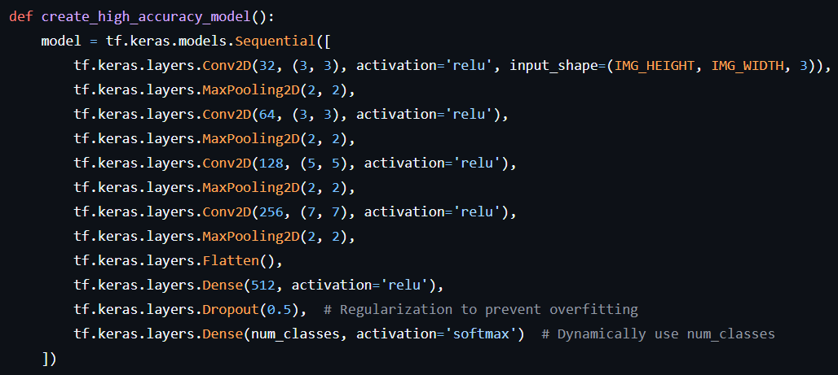
Implementation of module with codes
Github Repository Link:
https://github.com/GalexyBrain/CNN-For-Blood-Group-Detection-using-fingerprint.git
Notes:
Arduino is an open-source product, software/hardware which is accessible and flexible to customers.
Arduino is flexible because of offering variety of digital and analog pins, SPI and PWM outputs.
Arduino is easy to use, connected to a computer via a USB and communicates using serial protocol.
Inexpensive, around 500 rupees per board with free authoring software.
Arduino has growing online community where lots of source code is available for use, share and post examples for others to use too. Arduino is Cross-platform, which can work on Windows, Mac or Linux platforms.
Arduino follows Simple, clear programming environment as C language.

Slide 10

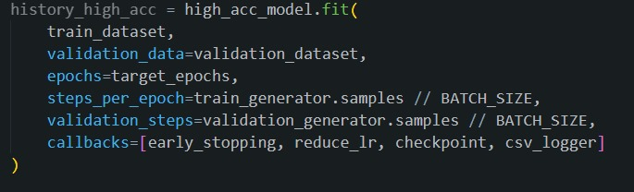
Implementation of module with codes
Notes:
Arduino is an open-source product, software/hardware which is accessible and flexible to customers.
Arduino is flexible because of offering variety of digital and analog pins, SPI and PWM outputs.
Arduino is easy to use, connected to a computer via a USB and communicates using serial protocol.
Inexpensive, around 500 rupees per board with free authoring software.
Arduino has growing online community where lots of source code is available for use, share and post examples for others to use too. Arduino is Cross-platform, which can work on Windows, Mac or Linux platforms.
Arduino follows Simple, clear programming environment as C language.

Slide 11








Results
Features | A | B | AB | O
+ve | Horse Shoe | Small concentric loops | Small circles | Heart shapes
-ve | Circle with T inside | Big concentric loops | Arc with spots | Circle with + inside
Notes:
Arduino is an open-source product, software/hardware which is accessible and flexible to customers.
Arduino is flexible because of offering variety of digital and analog pins, SPI and PWM outputs.
Arduino is easy to use, connected to a computer via a USB and communicates using serial protocol.
Inexpensive, around 500 rupees per board with free authoring software.
Arduino has growing online community where lots of source code is available for use, share and post examples for others to use too. Arduino is Cross-platform, which can work on Windows, Mac or Linux platforms.
Arduino follows Simple, clear programming environment as C language.

Slide 12
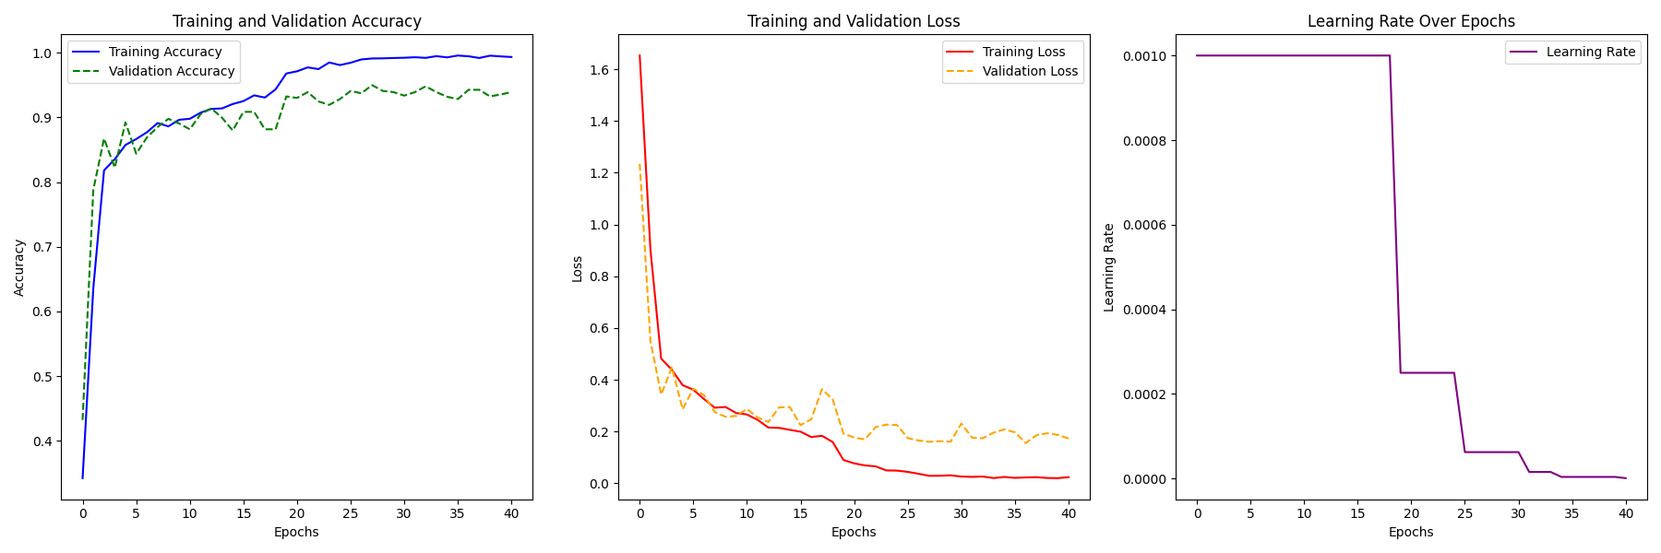
Results
Notes:
Arduino is an open-source product, software/hardware which is accessible and flexible to customers.
Arduino is flexible because of offering variety of digital and analog pins, SPI and PWM outputs.
Arduino is easy to use, connected to a computer via a USB and communicates using serial protocol.
Inexpensive, around 500 rupees per board with free authoring software.
Arduino has growing online community where lots of source code is available for use, share and post examples for others to use too. Arduino is Cross-platform, which can work on Windows, Mac or Linux platforms.
Arduino follows Simple, clear programming environment as C language.

Slide 13
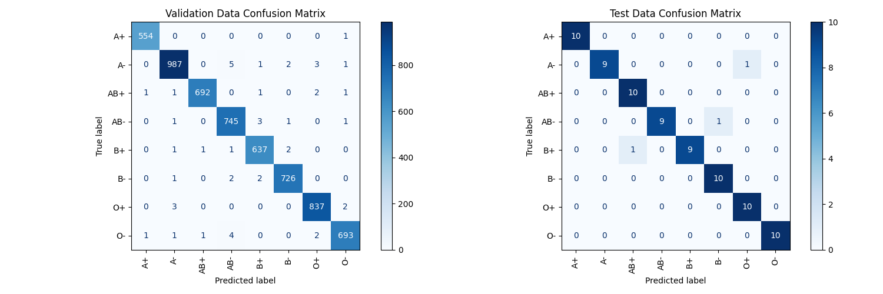
Results
Notes:
Arduino is an open-source product, software/hardware which is accessible and flexible to customers.
Arduino is flexible because of offering variety of digital and analog pins, SPI and PWM outputs.
Arduino is easy to use, connected to a computer via a USB and communicates using serial protocol.
Inexpensive, around 500 rupees per board with free authoring software.
Arduino has growing online community where lots of source code is available for use, share and post examples for others to use too. Arduino is Cross-platform, which can work on Windows, Mac or Linux platforms.
Arduino follows Simple, clear programming environment as C language.

Slide 14
Future Enhancements
Real-time Fingerprint Matching: Enhance the system to work in real-time for quicker identification.
Integration with Mobile Devices: Developing mobile applications for on-the-go blood group identification.
Improved Accuracy: Research on optimizing the machine learning algorithms to increase accuracy.
Bigger and Dataset For Improved Generalization: Adding more diverse fingerprint samples can enhance accuracy and reliability.
Notes:
Arduino is an open-source product, software/hardware which is accessible and flexible to customers.
Arduino is flexible because of offering variety of digital and analog pins, SPI and PWM outputs.
Arduino is easy to use, connected to a computer via a USB and communicates using serial protocol.
Inexpensive, around 500 rupees per board with free authoring software.
Arduino has growing online community where lots of source code is available for use, share and post examples for others to use too. Arduino is Cross-platform, which can work on Windows, Mac or Linux platforms.
Arduino follows Simple, clear programming environment as C language.

Slide 15
References
Journal Papers:
[1] Swathi P, Sushmita K, Prof. Kavita V Horadi, “Fingerprint Based Blood Group Prediction Using Deep Learning.”, ISSN (Online) 2581-9429, Volume 4, Issue 1, February 2024.
[2] T Nihar, K Yeswanth and K Prabhakar, “Blood group determination using fingerprint.”, ICMED 2024, MATEC Web of Conferences 392, 01069 (2024).
[3] G. Mounika, M. Anusha, D. Gopika, B. Siva kumari, “Blood group detection through finger print images using image processing (KNN)”, e-ISSN: 2395-0056, p-ISSN: 2395-0072, Volume: 11 Issue: 03 | Mar 2024.
[4] Vijaykumar Patil, D. R. Ingle, “A Novel Approach for ABO Blood Group Prediction using Fingerprint through Optimized Convolutional Neural Network”, ISSN:2147-6799, IJISAE, 2022, 10(1), 60–68.
Notes:
Arduino is an open-source product, software/hardware which is accessible and flexible to customers.
Arduino is flexible because of offering variety of digital and analog pins, SPI and PWM outputs.
Arduino is easy to use, connected to a computer via a USB and communicates using serial protocol.
Inexpensive, around 500 rupees per board with free authoring software.
Arduino has growing online community where lots of source code is available for use, share and post examples for others to use too. Arduino is Cross-platform, which can work on Windows, Mac or Linux platforms.
Arduino follows Simple, clear programming environment as C language.

